Slide 1
Capstone Project - AllianceBernstein
Weekly Update
3.27
Hongyu Dai

Slide 2
Previous takeaway
Upload all CA data to github
Using redfine data to explore relationship between house price https://www.redfin.com/news/data-center/
Talk about some data analysis methods

Slide 3
Summary
CA data
All available reports have been upload to GitHub
Code have been uploaded.
Next steps: documentation of code and creation of a build pipeline.
Note: The following page links are not clickable:
SpecEd 2018-19 02+ALPINE
SpecEd 2018-19 22+MARIPOSA
SpecEd 2017-18 02+ALPINE
SpecEd 2017-18 08+DEL+NORTE
SpecEd 2017-18 22+MARIPOSA
TX data
Explore the impact factors of house prices.

Slide 4
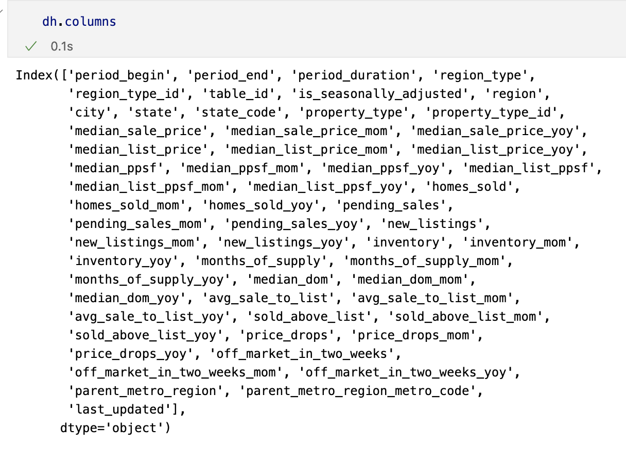
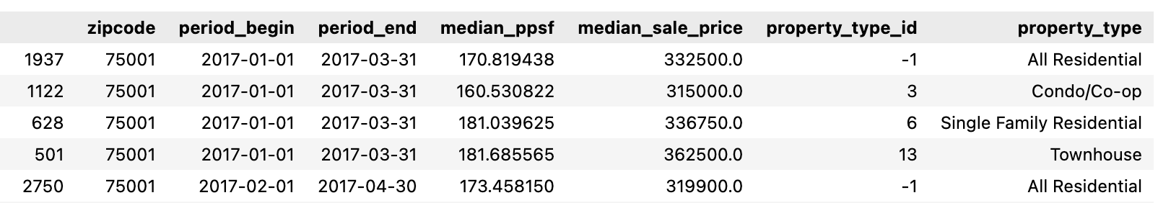
TX data - Explore the relationship with House price
Deal with house price data
Select key(?) columns: 'zipcode','period_begin', 'period_end','median_ppsf','median_sale_price' 'property_type_id','property_type'
Take ‘median_sale_price' as target factor since there is na value in 'median_ppsf'

Slide 5
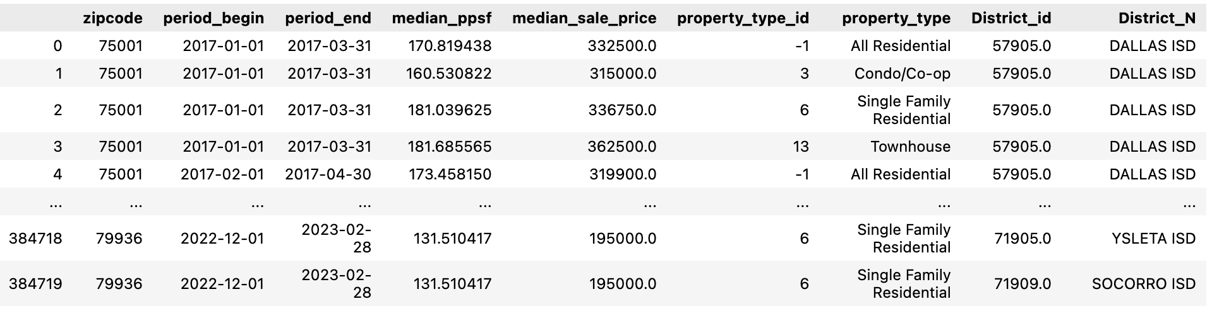
TX data - Explore the relationship with House price
Combine all TAPR_District data together based on their respective years to create a complete dataset.
Merging Zipcode and District ID Data
Inner Merge of House Price Data:
Perform an inner merge of the house price data with the zipcode-district data to determine the corresponding house price changes in each district.
Create a new column called 'years' based on the 'period_end' column
Split the dataframe according to the 'year' column.
Combine two datasets belonging to the same year for impact analysis.

Slide 6
TX data - Explore the relationship with House price
Variable Impact Analysis (On going)
Use Random Forest Regression Model to analyze the impact of various factors on house prices.
Use the 'feature_importances_' attribute to obtain the 30 most important features.
Compute Correlation Matrix
Convert Correlation Matrix for visualization as a heatmap.
Obtain Regression Coefficients
Use feacture selection method(eg. RandomForestClassifier) to select top 30 most important features.
Difficult: data is too large, running time is too long

Slide 7
Next Step
CA Data
Code Documentation: Document the code to make it easier to understand and maintain.
Build Pipeline: Create a build pipeline to automate the process of building and testing the code.
TX Data
House Price Impact Analysis: Analyze the impact of various factors on house prices in Texas using the available data.

